Slide 1
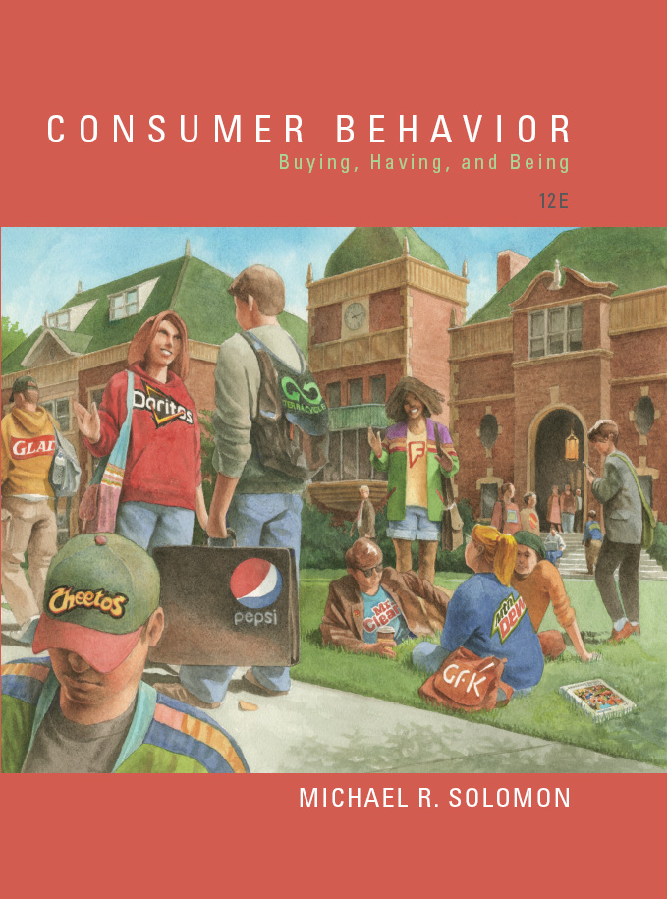
Consumer Behavior: Buying, Having, and Being
Twelfth Edition
Chapter 7
Personality, Lifestyles, and Values
Copyright © 2017, 2015, 2013 Pearson Education, Inc. All Rights Reserved.
Notes:
If this PowerPoint presentation contains mathematical equations, you may need to check that your computer has the following installed:
1) MathType Plugin
2) Math Player (free versions available)
3) NVDA Reader (free versions available)
This chapter defines the scope of international business and introduces us to some of its most important topics.

Slide 2
Learning Objectives (1 of 2)
7.1 A consumer’s personality influences the way he or she responds to marketing stimuli, but efforts to use this information in marketing contexts meet with mixed results.
7.2 Brands have personalities.
7.3 A lifestyle defines a pattern of consumption that reflects a person’s choices of how to spend his or her time and money, and these choices are essential to define consumer identity.

Slide 3
Learning Objectives (2 of 2)
7.4 It can be more useful to identify patterns of consumption than knowing about individual purchases when organizations craft a lifestyle marketing strategy.
7.5 Psychographics go beyond simple demographics to help marketers understand and reach different consumer segments.
7.6 Underlying values often drive consumer motivations.

Slide 4

Learning Objective 7.1
A consumer’s personality influences the way he or she responds to marketing stimuli, but efforts to use this information in marketing contexts meet with mixed results.
Notes:
This chapter begins by considering how people appear based on the products we surround ourselves with. Phil, pictured, is meeting his girlfriend’s parents. He’s surprised to find that even though Marilyn hinted the family had money that the family had very plain surroundings.

Slide 5
Freud
ID
Ego
Superego
Notes:
The id is about immediate gratification—it is the “party animal” of the mind. It operates according to the pleasure principle; that is, our basic desire to maximize pleasure and avoid pain guides our behavior. The id is selfish and illogical. It directs a person’s psychic energy toward pleasurable acts without any regard for consequences. The superego is the counterweight to the id. This system is essentially the person’s conscience. It internalizes society’s rules (especially as parents teach them to us) and tries to prevent the id from seeking selfish gratification. Finally, the ego is the system that mediates between the id and the superego. It’s basically a referee in the fight between temptation and virtue. The ego tries to balance these opposing forces according to the reality principle, which means it finds ways to gratify the id that the outside world will find acceptable. These conflicts occur on an unconscious level, so the person is not necessarily aware of the underlying reasons for his or her behavior.

Slide 6
Motivational Research and Consumption Motives
Power-masculinity-virility
Security
Eroticism
Moral purity-cleanliness
Social acceptance
Individuality
Status
Femininity
Reward
Mastery over environment
Disalienation
Magic-mystery
Notes:
Motivational research borrowed Freudian ideas to understand the deeper meanings of products and advertisements. The approach assumed that we channel socially unacceptable needs into acceptable outlets including product substitutes. The perspective relies on depth interviews with individual consumers. The slide shows a list of consumption motives identified by Ernest Dichter. Dichter was a psychoanalyst who trained with Freud’s disciples in Vienna. Dichter conducted in-depth interview studies on more than 230 products.

Slide 7
Neo-Freudian Theories
Karen Horney
Compliant versus detached versus aggressive
Alfred Adler
Motivation to overcome inferiority
Harry Stack Sullivan
Personality evolves to reduce anxiety
Carl Jung
Developed analytical psychology
Notes:
Freud’s work has a huge influence on theories of personality. However, many of his colleagues and students felt that there should be less emphasis on sexual conflicts and more on relationships. These theorists are known as neo-Freudian theorists. Some of the most notable are listed on the slide. Karen Horney described people as moving toward others, away from others, or against others. Adler proposed that a prime motivation is to overcome feelings of inferiority relative to others. Sullivan focused on how personality evolves to reduce anxiety in social relationships. Carl Jung is discussed more on the following slide.

Slide 8
Carl Jung, Father of Analytical Psychology
Disciple of Freud
Established concept of collective unconscious
Explained the creation of archetypes
Old wise man
Earth mother
Young & Rubicam uses the concept of archetypes in its BrandAsset® Archetypes model
Notes:
Carl Jung was also a disciple of Freud but their relationship ended in part because Jung did not accept Freud’s emphasis on sexual aspects of personality. Jung developed his own method psychotherapy known as analytical psychology.
He believed that we all share a collective unconscious. You can think of this collective unconscious as a storehouse of memories we inherited from our ancestors. From these shared memories, we recognize archetypes. An archetype is a universally recognized idea or behavior pattern. They typically involve themes like birth and death and appear in myths, stories, and dreams.
Young & Rubicam, a major advertising agency, uses the archetype approach in its BrandAsset Archetypes model shown in the figure (and depicted on the next two slides).

Slide 9
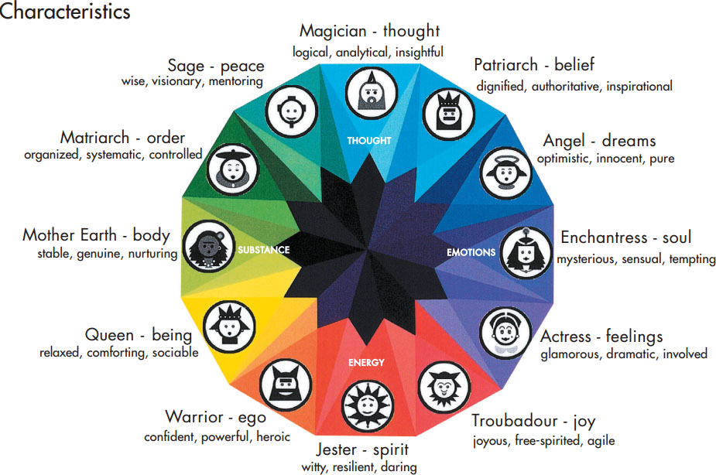
Brand Asset Valuator Archetypes (1 of 2)
Notes:
The model shows the relationships among the Archetypes. For each healthy personality, there is a corresponding Shadow. The Shadows are shown on the next slide. A healthy personality is one in which the Archetypes overwhelm their corresponding Shadows. A sick personality results when one or more Shadows prevail. When a brand’s Shadows dominate, this cues the agency to take action to guide the brand to a healthier personality.

Slide 10
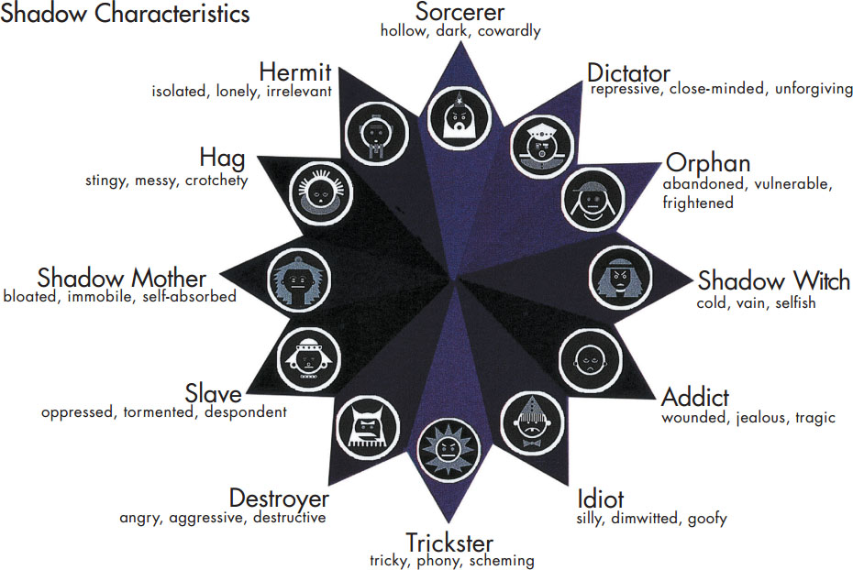
Brand Asset Valuator Archetypes (2 of 2)
Notes:
This slide illustrates the Shadows that correspond to the Archetypes.

Slide 11
Trait Theory
Personality traits: identifiable characteristics that define a person
Traits relevant to consumer behavior:
Innovativeness
Materialism
Self-consciousness
Need for cognition
Frugality
Notes:
Trait theory focuses on the quantitative measurement of personality traits. Personality traits are the identifiable characteristics that define a person. For instance, we might say that someone is an introvert or an extrovert. Some of the most relevant traits for consumer behavior are listed in the slide. Innovativeness is the degree to which a person likes to try new things. Materialism is the amount of emphasis a person places on acquiring and owning products. Self-consciousness is the degree to which a person deliberately monitors and controls the image of the self that he or she projects to others. The need for cognition is the degree to which a person likes to think about things and by extension, expends the necessary effort to process brand information. Frugality is the tendency to deny short-term purchases and to make due with what they already own. The use of standard personality trait measurements to predict product choices has met with mixed success. It is simply hard to predict consumer behavior based on personality! There are several explanations.

Slide 12
The Big Five
Table 7.3 Description of Big Five Personality Dimensions
Blank | Description | Example of Measurement Items (agree/disagree)
Openness to experience | The degree to which a person is open to new ways of doing things | Love to think up new ways of doing things
Conscientiousness | The level of organization and structure a person needs | Am always prepared
Extroversion | How well a person tolerates stimulation from people | Talk to a lot of different people at parties
Agreeableness | The degree to which we defer to other people | Take time out for others
Neuroticism (emotional instability) | How well a person copes with stress | Get upset easily
Source: Michael R. Solomon, Rebekah Russell-Bennett, and Josephine Previte, Consumer Behaviour: Buying, Having, Being, 3rd ed., Frenchs Forest, N S W: Pearson Australia, 2012.
Notes:
The most widely recognized approach to measuring personality traits is the Big Five (also known as the Neo-Personality Inventory). This is a set of five dimensions that form the basis of personality: openness to experience, conscientiousness, extroversion, agreeableness, and neuroticism. Table 7.4 describes these dimensions.

Slide 13
MBTI
Focus of attention
Information processing
Decision making
Dealing with outer world
Notes:
The Myers-Briggs Type Indicator, which is based on Carl Jung’s work, is another widely used personality test. The Myers-Briggs classifies people into 16 categories based upon whether they fall into one group or another on these dimensions. First is focus of attention which may be introversion or extraversion. Second is how we process information which may be sensing or intuition. Sensing means to take in information in a sequential, step-by-step manner while intuition means to take in information in a snapshot or big-picture manner. Third is decision-making which is a continuum between thinking and feeling. Fourth is how we deal with the outer world. We will fall along a continuum between judging and perceiving. Judging is a systematic approach to meeting deadlines and achieving objectives while perceiving is a spontaneous approach to meeting deadlines and achieving objectives.

Slide 14
For Reflection (1 of 5)
Describe a time when the Id took over on purchase consumption. Did you keep the item?

Slide 15
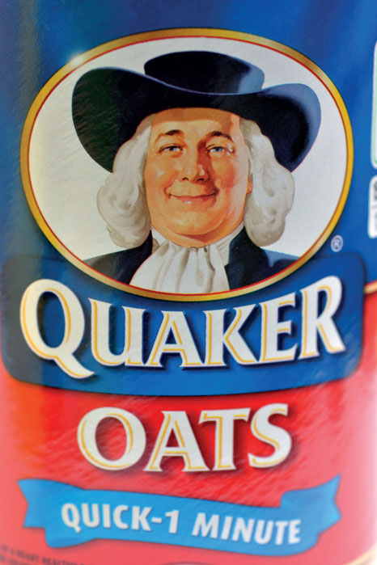
Learning Objective 7.2
Brand have personalities.

Slide 16
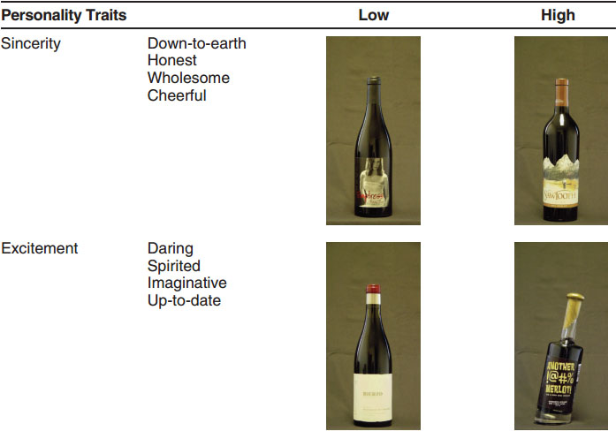
An Example of Brand Personality
Source: Reprinted with permission from Journal of Marketing, published by the American Marketing Association, Ulrich R. Orth & Keven Malkewitz, May 2008, Vol. 72, p. 73.
Notes:
A study found that consumers infer strong differences in a wine’s “personality” based on the bottle’s label design. The text shows more examples of wine personality based on label design.

Slide 17
Brand Personality
Brand personality: set of traits people attribute to a product as if it were a person
Reader response theory
Underdog brand biography
Anthromorphism
Doppleganger brand image
Notes:
A product that creates and communicates a distinctive brand personality stands out from its competition, earns brand equity, and inspires years of loyalty.
Reader response theory, which is a widely accepted perspective in literature that focuses on the role of the reader in interpreting a story rather than just relying upon the author’s version.
Underdog brand biography. This includes details about a brand’s humble origins and how it defied the odds to succeed.
Anthropomorphism refers to the tendency to attribute human characteristics to objects or animals.
Doppelgänger brand image (one that looks like the original but is in fact a critique of it).

Slide 18
Brand Behaviors and Possible Personality Trait Inferences
Brand Action | Trait Inference
Brand is repositioned several times or changes slogan repeatedly | Flighty, schizophrenic
Brand uses continuing character in advertising | Familiar, comfortable
Brand charges high prices and uses exclusive distribution | Snobbish, sophisticated
Brand frequently available on deal | Cheap, uncultured
Brand offers many line extensions | Versatile, adaptable
Notes:
There are many things a marketer can do to influence consumers’ perceptions of a brand’s personality. Consumers will infer things about a brand’s personality from the brand’s positioning in the marketplace.

Slide 19
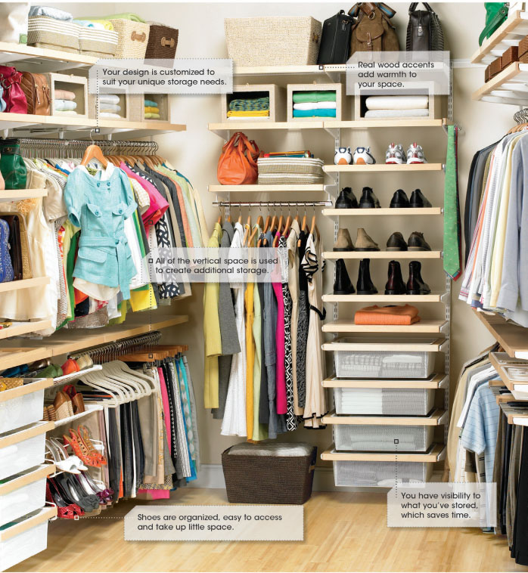
Closet Products and Personality
Notes:
This ad relates closet products and personality.

Slide 20
For Reflection (2 of 5)
How can marketers link a brand’s personality with the lifestyle of a consumer segment?

Slide 21
Learning Objective 7.3
A lifestyle defines a pattern of consumption that reflects a person’s choices of how to spend his or her time and money, and these choices are essential to define consumer identity.

Slide 22
Lifestyles and Consumer Identity
Lifestyles
E-sports
Metro
Hesher
Emo
Lifestyle marketing perspective
Notes:
●● Metro: You just can’t walk past a Banana Republic store without making a purchase. You own 20 pairs of shoes, half a dozen pairs of sunglasses, just as many watches,
and you carry a man-purse. You see a stylist instead of a barber because barbers don’t do highlights. You can make lamb shanks and risotto for dinner and Eggs Benedict for
breakfast … all from scratch. You shave more than just your face. You also exfoliate and moisturize.
●● Hesher: A Reebok-wearing, mulleted person in acid-washed jeans and a Judas Priest T-shirt who still lives in his or her parents’ basement, swears that he or she can really
rock out on his or her Ibanez Stratocaster copy guitar, and probably owns a Nova that hasn’t run in five years.
●● Emo: Someone into soft-core punk music that integrates high-pitched, overwrought lyrics and inaudible guitar riffs. He or she wears tight wool sweaters, tighter jeans,
itchy scarves (even in the summer), ripped chucks with their favorite band’s signature, black square-rimmed glasses, and ebony greasy unwashed hair that is required to
cover at least three-fifths of the face at an angle.
Lifestyle marketing perspective recognizes that people sort themselves into groups on the basis of the things they like to do, how they like to spend their leisure
time, and how they choose to spend their disposable income.

Slide 23
Learning Objective 7.4
Identifying patterns of consumption can be more useful than knowing about individual purchases when organizations craft a lifestyle marketing strategy.
Notes:
A goal of lifestyle marketing is to allow consumers to pursue their chosen ways to enjoy their lives and express their social identities. Many products and services seem to go together. Importantly, products can have meaning in establishing a person’s lifestyle.

Slide 24
Product Complementarity and Co-Branding Strategies (1 of 2)
Co-branding strategies- companies team up to promote 2 or more products.
Product complementarity- occurs when symbolic meanings of different products relate to one another.
Consumption constellation
Notes:
Consumption constellation is used to define, communicate, and perform social roles.61 For example, we identified the U.S. “yuppie” of the 1980s by such products as a Rolex watch, a BMW automobile, a Gucci briefcase, a squash racket, fresh pesto, white wine, and brie cheese. Researchers find that even children are adept at creating consumption constellations, and
as they get older they tend to include more brands in these cognitive structures.

Slide 25
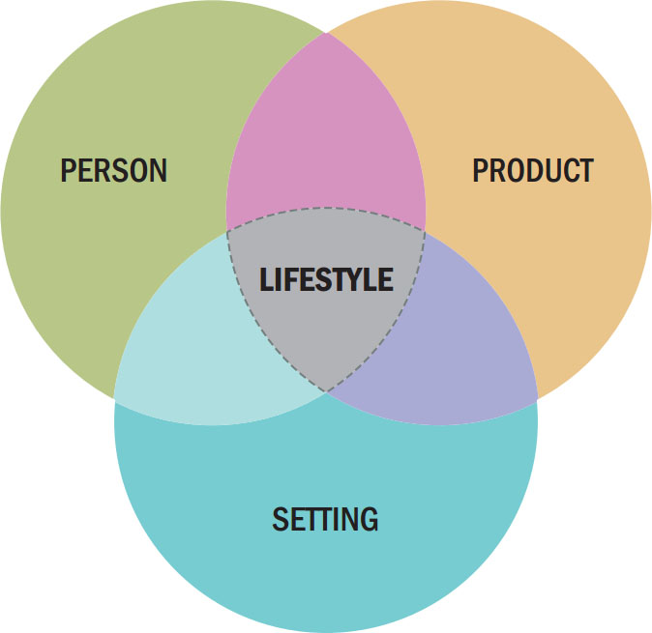
Product Complementarity and Co-Branding Strategies (2 of 2)
Figure 7.3 Consumption Style
Notes:
The desire to associate a product with a social situation is a long-standing one for advertisers whether they include a product in a round of golf, a family barbecue, or a night out. People, products, and settings result in an expressed consumption style which can be used as a cue.

Slide 26
For Reflection (3 of 5)
Identify products and settings that would be at home in your consumption styles.
Have marketers identified these consumption styles and used them in advertising?

Slide 27
Learning Objective 7.5
Psychographics go beyond simple demographics to help marketers understand and reach different consumer segments.
Notes:
Psychographics involve the use of psychological, sociological, and anthropological factors to determine how the market is segmented by the propensity of groups within the market and their reasons for making particular decisions. Sometimes it is called lifestyle segmentation.

Slide 28
Psychographic Analysis
Lifestyle profile
Product-specific profile
General lifestyle segmentation
Product-specific segmentation
Notes:
There are several ways to do a psychographic analysis.
A lifestyle profile looks for items that differentiate between users and nonusers of a product.
A product-specific profile identifies a target group and then profiles these consumers on product-relevant dimensions.
A general lifestyle segmentation places a large sample of respondents into homogenous groups based on similarities of their overall preferences.
A product-specific segmentation study tailors questions to a product category.

Slide 29
AIOs
Table 7.6 AIO Dimensions
Activities | Interests | Opinions | Demographics
Work | Family | Themselves | Age
Hobbies | Home | Social issues | Education
Social events | Job | Politics | Income
Vacation | Community | Business | Occupation
Entertainment | Recreation | Economics | Family size
Club membership | Fashion | Education | Dwelling
Community | Food | Products | Geography
Shopping | Media | Future | City size
Sports | Achievements | Culture | Stage in life cycle
Source: William D. Wells and Douglas J. Tigert, “Activities, Interests, and Opinions,” Journal of Advertising Research 11 (August 1971): 27–35. © 1971 by The Advertising Research Foundation. Used with permission.
Notes:
Table 7.6 in the text reveals a more comprehensive view of lifestyle dimensions. In the slide you can see some examples of people’s primary activities, interests, and opinions.

Slide 30
Uses of Psychographic Studies
Define target market
Create a new view of market
Position the product
Better communicate product attributes
Develop product strategy
Market social and political issues
Notes:
Marketers can use psychographic studies in many ways. Several of the most common uses are listed in the slide.

Slide 31
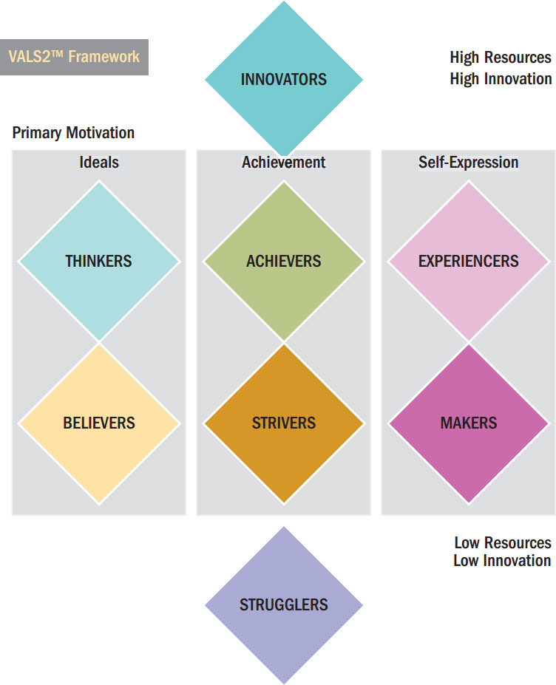
Figure 7.4 VALS2
Notes:
One of the most well-known segmentation systems is The Values and Lifestyles System, also called VALS2. It is based on segments grouped by self-orientation and resources. Self-orientation may be based on ideals, achievement, and self-expression. Resources range from high to low.
Innovators are those whose high resources result in less emphasis on self-orientation. Strugglers are those whose low resources also result in little emphasis on self-orientation.

Slide 32
For Reflection (4 of 5)
Which VALS category would you guess you are in? Why?
Do you see possible linkages between brand images and the segments in the VALS system?
Notes:
Brands can reveal self-orientations too. Some brands will seem more focused on ideals; others on achievement. Do you see examples in which those brands are clearly targeting specific VALS segments?

Slide 33
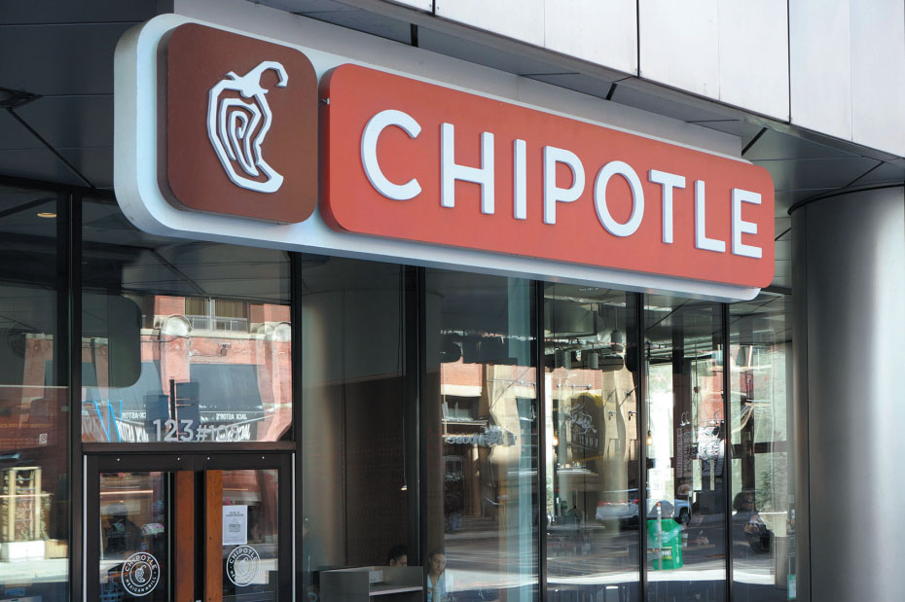
Learning Objective 7.6
Underlying values often drive consumer motivations
Notes:
A value is a belief that some condition is preferable to its opposite. A person’s set of values plays a very important role in consumption activities. Consumers purchase many products and services because they believe these products will help to attain a value-related goal.

Slide 34
Value Concepts
Core values
Value systems
Enculturation
Acculturation
Crescive norms
Custom
More
Conventions
Notes:
A value is a belief that some condition is preferable to its opposite. In some cases, values are universal. We all value health, wisdom, and peace. What sets cultures apart is the relative importance of these universal values. This set of rankings constitutes a culture’s value system. It is usually possible to identify a general set of core values that uniquely define a culture.
Core values such as freedom, youthfulness, achievement, materialism, and activity characterize American culture.
The process of learning the beliefs and behaviors endorsed by one’s own culture enculturation.
We call the process of learning the value system and behaviors of another culture acculturation.
Crescive norms we discover as we interact with others and these include customs, mores, and conventions.
A custom is a norm that controls basic behaviors such as division of labor in a household.
A more is a custom with a strong moral overtone. It may involve something that is taboo or forbidden like cannibalism.
Conventions are norms that regulate how we conduct our everyday lives. They may be subtle like how we furnish a room or what we wear to a dinner party.

Slide 35
How Values Link to Consumer Behavior (1 of 2)
Table 7.7 Terminal and Instrumental Values
Instrumental values | Terminal values
Ambitious | A comfortable life
Broad-minded | An exciting life
Capable | A sense of accomplishment
Cheerful | A world of peace
Clean | A world of beauty
Courageous | Equality
Forgiving | Family security
Helpful | Freedom
Notes:
The psychologist Milton Rokeach identified terminal values which are desired end states. The Rokeach Value Survey also identifies instrumental values which are those actions we need to take to achieve these terminal values. Table 3.1 lists several instrumental values and their corresponding terminal values.

Slide 36
How Values Link to Consumer Behavior (2 of 2)
[Table 7.7 continued]
Instrumental values | Terminal values
Honest | Happiness
Imaginative | Inner harmony
Independent | Mature love
Intellectual | National security
Logical | Pleasure
Loving | Salvation
Obedient | Self-respect
Polite | Social recognition
Responsible | True friendship
Self-controlled | Wisdom
Source: Copyright 1983 From Measuring the Cultural Values Manifest in Advertising,” Current Issues and Research in Advertising (1983): 71–92 by Richard Pollay. Reproduced by permission of the American Academy of Advertising (aaoa.wildapricot.org)

Slide 37
Other Value Concepts
The List of Values (LOV)
The Means-End Chain Model
Syndicated Surveys of Values (e.g., VALS)
Notes:
The list of values (LOV) scale isolates values with more direct marketing applications. This instrument identifies nine consumer segments based on the values members endorse.
The means-end chain model assumes that people link very specific product attributes indirectly to terminal values. A technique researchers call laddering uncovers consumer associations between specific attributes and these general consequences. The ladder connects abstract concepts to functional product attributes.
A number of companies track changes in values through large-scale surveys.

Slide 38
For Reflection (5 of 5)
How do you assign people to social classes, or do you at all?
What consumption cues do you use (e.g., clothing, speech, cars, etc.) to determine social standing?

Slide 39
Chapter Summary (1 of 3)
A consumer’s personality influences the way he or she responds to marketing stimuli, but efforts to use this information in marketing contexts meet with mixed results.
Brands have personalities.
Notes:
We’ve reviewed many concepts in this chapter. The key points are noted in the slide.

Slide 40
Chapter Summary (2 of 3)
A lifestyle defines a pattern of consumption that reflects a person’s choices of how to spend his or her time and money, and these choices are essential to define consumer identity.
It can be more useful to identify patterns of consumption than knowing about individual purchases when organizations craft a lifestyle marketing strategy.
Notes:
We’ve reviewed many concepts in this chapter. The key points are noted in the slide.

Slide 41
Chapter Summary (3 of 3)
Psychographics go beyond simple demographics to help marketers understand and reach different consumer segments.
Underlying values often drive consumer motivations.

Slide 42

Copyright

